Slide 1

Introduction To Tools
M1-D1
Participate! The more engagement the better!
You are NEVER interrupting me!

Slide 2
BootcampOS

Slide 3

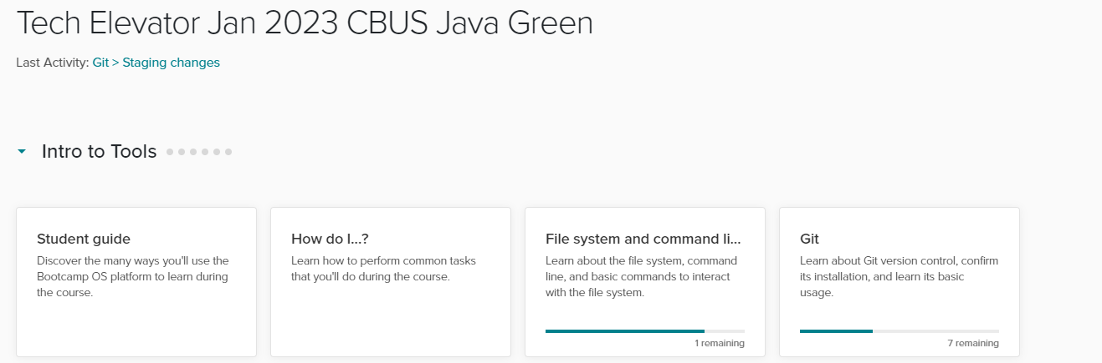
| Bootcamp OS Check
In Chrome, go to
https://lms.techelevator.com/
Log in using your username and password

Slide 4
Git Configuration (in class!)

Slide 5

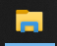
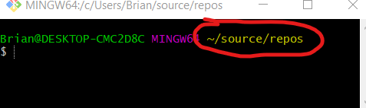
| Open Your Working directory
Open Windows File Explorer
Under This PC select C:
Then User → Student → source → repos (C:\Users\Student\source\repos)
Right click in the folder and select
This will open the Git Bash terminal in this folder. Verify that it shows ~/source/repos at the end of the first line.

Slide 6

| Getting to your Repository
In the Chrome Browser go to
https://git.techelevator.com/
Login using your GitLab account
Click on the Repository named:
Your Name Student Code
Ex. Bart Simpson Student Code
**Do not select the Instructor Code repo**

Slide 7
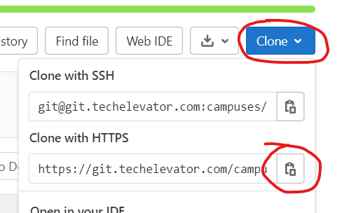
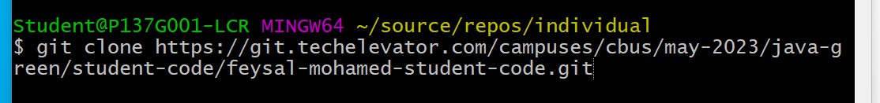
| Cloning your Repository
On the repository page click the Clone button on the upper right.
Click the Copy to Clipboard button beside Clone with HTTPS
Return to the Git Bash window and type git clone then right-click and select paste
Once the address has been pasted press the Enter key. You will need to enter your GitLab username and password.
Password Entry will not show anything as you type!

Slide 8
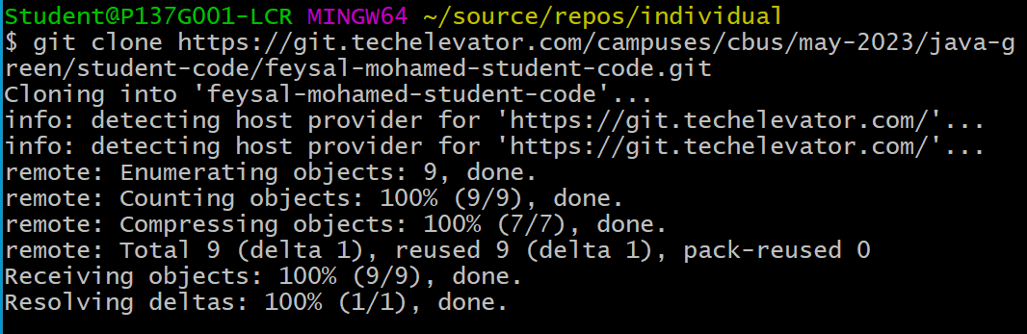
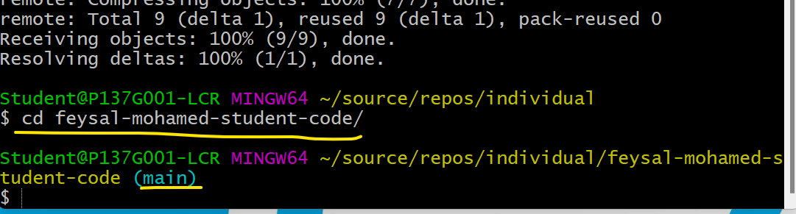
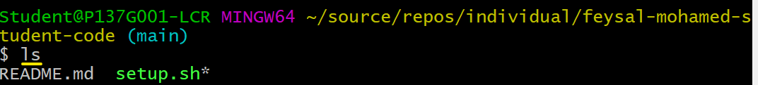
| Change to your local repository
Once the clone completes
type cd your-name-student-code, where your-name is your first-last name, and press Enter
Verify you are now in your student-code folder, if you enter the command: ls you should see the setup.sh* file
Notice the (main) at the end, indicating we are on the main git branch of a repo. If you don’t see (main) at the end of the line, you are not in your repo. Repeat the above step to cd your-name-student-code.

Slide 9
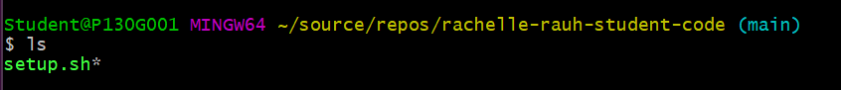
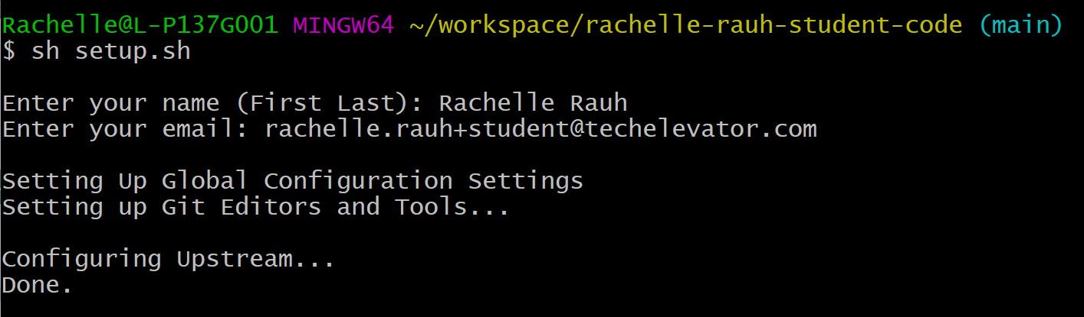
| Run the setup Script
Run the setup script by typing sh setup.sh and pressing enter, it will ask for your first and last name and email address.
Use your real name and email. Potential employers will see this information!
sh setup.sh

Slide 10
| Pull from upstream
Type git pull upstream main and press enter to pull recent changes from the upstream repository that was just configured.
git pull upstream main
Make sure you are in your student repository!!

Slide 11
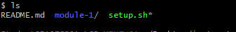

| Verify it worked
Type ls and press enter you should see a new module-1 directory listed.
If you see the module-1 folder listed then you are done and your configuration was successful!

Slide 12
THE FILE SYSTEM

Slide 13
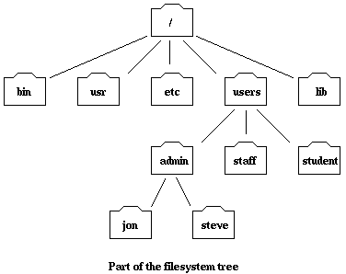
Root directory
The root directory is the start of the file system. It is denoted by a forward slash → /
Operating System Root (Unix, Linux, Mac OS, Windows)
A filesystem is hierarchical (resembling a tree structure). The tree is anchored at a place called the root, designated by a slash "/". Every item in the filesystem tree is either a file, or a directory.

Slide 14

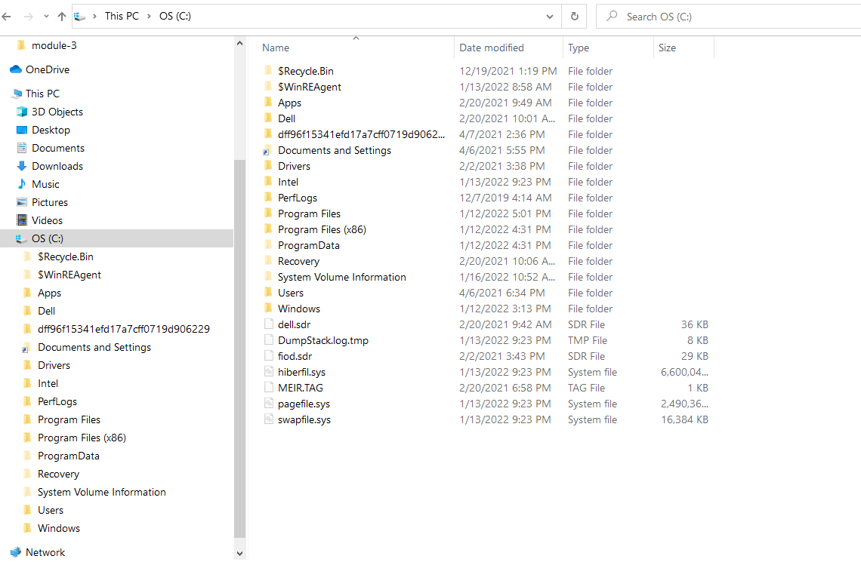
FILE EXPLORER

Slide 15
THE SHELL (AKA TERMINAL / COMMAND LINE / GITBASH)
https://www.geeksforgeeks.org/difference-between-terminal-console-shell-and-command-line/

Slide 16
BASH Shell
What is BASH?
There are many types of shells available on computer systems. Each Shell has its own set of commands. BASH is a commonly used UNIX-based shell that is available on Mac OS, Linux, and Windows.
Why use a shell?
Many programming tasks are more flexible and faster in the Shell
It can be scripted, which means we can write our own reusable commands
Many programming tools do not have graphical user interfaces (GUI), or have more options available in the shell version. Often the GUI for these tools and just for convenience and issue shell commands in the background, so if we don’t understand the shell commands, then we can’t troubleshoot problems we may encounter.

Slide 17
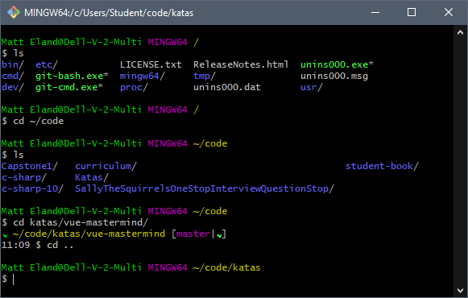

GIT BASH Our Shell of Choice

Slide 18

Absolute vs Relative Paths
You can traverse through the file system using an absolute or relative path.
The path to a location is an absolute path, if it is starting from the root anchor point.
/users/admin/steve → is the absolute path to get to the steve folder. It is a relative path, if you start from where your current location is. Like if you were in a sub-directory.
When specifying a path, you simply trace a route through the filesystem tree, listing the sequence of directories you pass through as you go from one point to another. Each directory listed in the sequence is separated by a slash.

Slide 19
Let’s Look At Our First Command - ls
ls | This is the ‘list’ command. It will list out files and directories in relation to where you are at on the file system.
ls -l | The -l option allows us to view details about the file (size, modified date, etc)
ls -a | The -a option shows all files (including hidden ones)
ls -la | ← You can even combine them.
 | Additional reference: https://www.tecmint.com/15-basic-ls-command-examples-in-linux/

Slide 20
Let’s Change To A Different Directory - cd
cd | This is the ‘change directory’ command. It expects a directory path. If you leave it blank it will take you to your home directory
cd / | This will always take me to the root directory on my machine (the start of the file system)
cd <directory name> | This will take me into the directory indicated inside the < >. For example: cd homework will take me down into the homework directory IF it exist
cd .. | This will take me UP one directory to my PARENT directory
cd ~ cd | This will always take me to my user home directory regardless of where I am. You can also use cd <enter>

Slide 21
Let’s Change To A Different Directory
We can also navigate across multiple directories by chaining the directories together using the file separator ‘/’
ex: cd Music/Albums
Takes us to the Albums directory that is inside the Music Directory. The Music directory is a child of our current working directory (Also called a sub-directory)
ex: cd ../../Projects
Takes you up 2 directories from our current working directory and then into its child directory called Projects
Any valid file path goes here

Slide 22

Help I Am Lost - Where Am I?
The pwd command gives us our current working directory that we in. pwd stands for Print Working Directory
Assume I am inside folderA which is inside the steve directory which is inside the users folder
$ pwd
/users/steve/folderA

Slide 23

Class: Let’s go play...
Open up Gitbash and try the various ls options…
What command would we use to display ALL the details (including hidden files)?
What command would we use to go up one directory? Two directories?
What command would we use to find out where we are?

Slide 24
Let’s Make A New Folder
Let’s create a temp directory inside our student directory (our home directory) $ cd (then hit enter key) ← This will take you to your home directory $ pwd (then hit enter key) ← This will print out the path so you can verify that you are there. The mkdir command is used when we want to create a new folder.
$ mkdir temp
This command makes a child directory called temp

Slide 25
Let’s Make A New File
There are half a dozen or more ways to create files. Option 2 or using another program like IntelliJ is what we usually use)
Option 1: $ touch note.txt (Touch will create a new file or update the timestamp on a file)
Option 2: $ code note2.txt (This will open Visual Studio Code editor)

Slide 26
Let’s Move A File or Folder
To move a folder or file to another location we use the mv command. The move command takes two arguments (1st: The file or folder you want moved 2nd: The location of where you want to move it to)
$ mv note.txt ../Documents
This will move the note.txt file in the current location UP a directory and then into it’s Documents sub folder. BUT ONLY if the Documents folder is the parent folder.

Slide 27
Let’s Rename A File Or Folder
We use the same mv command to rename a file. In this case the two arguments are (1st: The current file or folder you want to rename 2nd: The new name)
$ mv note.txt ../Documents/letter.txt
This will rename the note.txt file to letter.txt
*** This also works with folders.

Slide 28
Let’s Copy A File Or Folder
We use the cp command to make a copy of a file or folder. In takes two arguments or three arguments depending on whether or not you are copying file or directory. To copy a file:
$ cp note2.txt mycopy.txt ← This will make a copy of note.txt called mycopy.txt
To copy a directory:
$ cp -r Documents Document_Backup ← This will copy the directory and anything inside it
*** This also works with folders.
-r stands for recursive (Basically will continue down all child sub-directories until there are no more - e.g. everything inside the folder, etc..

Slide 29

Let’s Delete A File or Folder
We use the rm command to remove a file or folder.
$ rm note.txt
$ rm folderA ← This will NOT work because folders can’t be deleted without additional options.
$ rm -r folderA ← This will work because we are telling it to recurse inside. Note: Use extreme caution with this command.
Only do this if you know what you are doing. $ rmdir folderToDelete ← This will also delete an empty directory

Slide 30

Let’s Review… Need to know.
You should memorize and practice using: ls and ls -la
cd and how to move about the file system - up a directory - down a directory - etc.
pwd
The other commands can be referenced when needed or you will learn them over time. However you may see some of them on a quiz or exercise.

Slide 31
Source Code Repositories, GitLab and Git

Slide 32

Toy Story 2
Good stuff starts at ~ 4:00 in… Seriously, the first 4 minutes suck
https://www.youtube.com/watch?v=Hhr681TpZac
Do not watch now … lol

Slide 33
What is Git?
Git is a distributed, version control system. It is a software application used for tracking changes in computer files and coordinating work on those files among multiple people. It is used for:
Saving code changes in case your local copy gets corrupt, lost, accidently deleted, the dog ate your homework, etc.
Sharing code across teams and team members.
Comparing past versions, changes to files and who made them, parallel development, etc.
System of truth

Slide 34
What is GitLab, Github and Bitbucket?
GitLab, Github, Bitbucket are companies that host code repositories remotely based on git software. A code repository consist of all code/files that make a project.
When you make changes to your code on your laptop (locally), you push your changes to your repository (remote repository) which exists in GitLab. When you need to update your local machine with code someone else wrote, you pull the changes to your local computer.

Slide 35
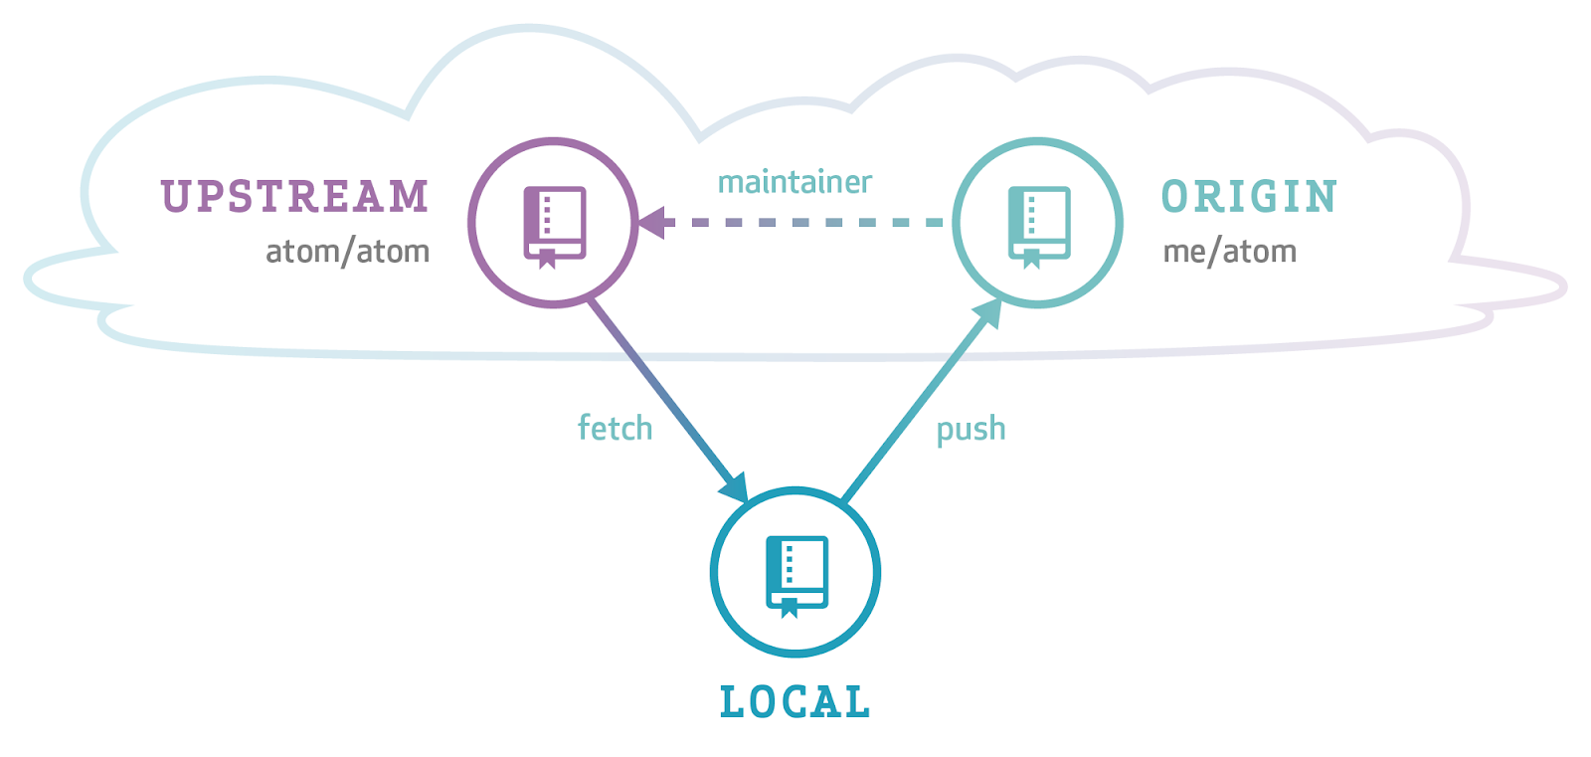
LOCAL REPOSITORY
Your Laptop
Instructor Code
Your Code
Your Laptop

Slide 36
ORIGIN
Your GitLab Repository
Origin is an alias name for your repository on GitLab
GitLab
Instructor Code
Your Code
Push Changes
Your Laptop

Slide 37
UPSTREAM
Your Instructor’s Repository
GitLab
Instructor Code
Your Code
Pull Changes
Push Changes
Your Laptop

Slide 38
GIT REPOSITORIES
local - Your laptop’s version of code. Nobody else can see this.
Nobody else has access to this.
origin - A GitLab-hosted version of your repository
This is what we pull from for grading
upstream - A GitLab-hosted repository with course assignments.
This is shared among the entire class and maintained by your instructors.
You will pull from this every morning
You have read-only access. You cannot write to this repository

Slide 39

Let’s Create A Visual Of Our GitLab Environment
GitLab
Instructor Code Repo
Student Name Repo
STEVE
(remote / upstream)
(remote / origin
push
pull
Student Name Repo
Exercises I assign and lecture code get pulled from upstream to your laptop’s local repo
Completed assignments and your copy of lecture code get pushed to origin

Slide 40
How To Check For An Upstream Repository
(One time task - THIS WAS DONE AS PART OF SETUP.SH SCRIPT)
Instructor Code is my instructor repository where you will pull exercises and lecture code from. You can’t PUSH code to this repository, only PULL.
Verify that your remote is configured:
$ git remote -v (then type enter)
origin https://carmichs@bitbucket.org/te-cbus-cohort-14/stevecarmichael-java-green-main.git (fetch) origin https://carmichs@bitbucket.org/te-cbus-cohort-14/stevecarmichael-java-green-main.git (push) upstream https://bitbucket.org/te-cbus-cohort-14/java-green-main (fetch) upstream https://bitbucket.org/te-cbus-cohort-14/java-green-main (push)
Ignore that URLs say bitbucket. Yours will say GitLab
Look for two origins and two upstreams

Slide 41
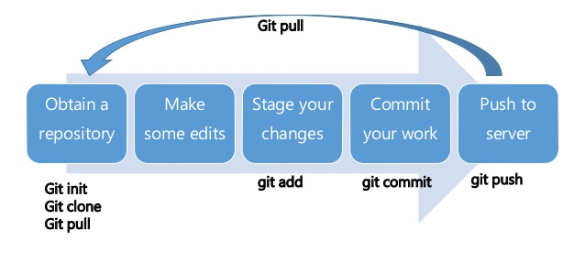


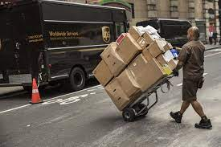
GIT WORKFLOW

Slide 42
GIT COMMANDS

Slide 43

git clone
Example: $ git clone https://git.techelevator.com/some-project-name.git
Remote (Bitbucket)
Your Computer
clone makes a copy of a remote repository as a local repository on your computer as a starting point.
This copy includes all the files and history from the remote repository. You only do this ONCE.
Local Repository
Remote Repository
clone
Origin

Slide 44
git add
packaging/preparing
Example: $ git add -A
Your Computer
add adds a set of files to the stage.
The stage is an area used to prepare for a commit, which allows more control over smaller commits.
The files to add must be included in the command. -A tells git to add all changes, including deletes.
Stage
Local Repository
add
staged
untracked/modified
git add -A

Slide 45
git commit
Example: $ git commit -m “completed exercise 1”
Attach a label / version
Your Computer
commit moves a set of changes from the stage to the local repository.
Committing is like saving the changes. When committed a history is created and changes become very difficult to lose.
Commit requires a message that describes the changes.
Stage
Local Repository
commit
staged
committed
untracked/modified
git commit -m “commit message”

Slide 46
git push
Example: $ git push origin main
Send to remote repo (origin)
Remote (GitLab)
push copies the changes and history from the local repository to the remote repository.
Once in the remote repository it is available for other developers on the team to access.
push requires name of the remote repository and the branch.
Your Computer
Local Repository
Remote Repository
push
committed
git push origin main

Slide 47
Workflow when using git (solo)
Always run commands inside your student code folder
Example: $ git add -A $ git commit -m “completed exercise 1” $ git push origin main
Remote (GitLab)
Your Computer
Stage
Local Repository
Remote Repository
add
commit
push
staged
committed
untracked/modified

Slide 48
git pull
Example: $ git add -A $ git commit -m “completed exercise 1” $ git pull upstream main
Remote (GitLab)
Your Computer
pull copies the changes and history made by other developers from the remote repository into the local repository.
pull requires name of the remote repository and the branch. upstream → remote repo main → branch
Local Repository
Remote Repository
pull
git pull upstream main

Slide 49
Getting new materials
In GitBash terminal
$ cd → This will make sure you are starting from your home directory
$ cd source/workspace/your-name-student-code
$ git add -A
$ git commit -m “your comment”
$ git pull upstream main
This ensures that all local work is safe, before pulling

Slide 50
Pushing work to GitLab
In GitBash terminal
$ cd → This will make sure you are starting from your home directory
$ cd source/workspace/your-name-student-code
$ git add -A
$ git commit -m “your comment”
$ git push origin main
Watch the output for failures! If you see a failure, reach out to an instructor ASAP.
You can verify what has been submitted by looking at the file in GitLab
You can push as often as you like. Only the last changes made will be reviewed.

Slide 51
Let’s Look At/Do Some Of The Homework

Slide 52
References for studying later
Know basic Linux commands (ls, mkdir, cd, cp, pwd) Know that a file system is hierarchical and follows a TREE structure Know what a shell program is
Know absolute vs. relative paths.
Know what cd .. and cd ~ does Be able to navigate around your machine using GitBash.
Practice getting to your student code directory
Know the purpose and reasons for a source code repository
Know what git, gitLab, gitHub is. Know the basic git commands we covered today and how to use them to pull work and push work. (clone, add, commit, push, pull, status ) Know the git workflow diagram Know what upstream and origin are.

Slide 53
GIT Commands
clone | Used to copy down a repository that has had committed changes (done once)
add | Used to stage files (these are the files you changed or added)
commit | Used to create a version for check-in
push | Pushes changes to your remote repository (you push to origin)
pull | Pulls down any new or changed code from the remote to your local repo
status | Checks to see what the status is of files read
Stages of a File
untracked | Git does not know about this file because it has not been added
modified | This file has been changed
staged | This file has been added
committed | This file is committed and ready to be pushed
GIT Mantra
Commit Early, Commit Often

Slide 54
GIT Commands
clone | $ git clone <url to repo>
Add (choose 1) | $ git add <filename> $ git add . $ git add -A
commit | $ git commit -m “some comment here”
push | $ git push origin main
pull | $ git pull upstream main (instructor repo) $ git pull origin main (pair projects, etc) upstream and origin at the aliases for the remote repo main is the main code branch
status | $ git status (lists status of changes if any)
log | $ git log (sometimes has useful info)
GIT Mantra:
Commit Early, Commit Often

